Slide 1








"DATA ANALYSIS OF HOTEL RESERVATIONS CLASSIFICATION"
“Exploring Booking Patterns, Cancellations, and Customer Behavior”
NISHTHA YADAV

Slide 2





WHAT IS DATA ANALYSIS?
UNDERSTANDING DATA, DRAWING CONCLUSIONS, AND USING THESE INSIGHTS TO MAKE INFORMED DECISIONS.
Data analysis is the process of examining, transforming, and interpreting data to extract meaningful insights, identify patterns, and support decision-making. It involves various techniques and tools to analyze raw data, turning it into valuable information that can be used for problem-solving and forecasting.
NISHTHA YADAV

Slide 3




IMPORTANCE OF DATA ANALYSIS !
DATA COLLECTIONS
DATA TRANSFORMATION
MODELING/ANALYSIS
DATA CLEANING
EXPLORATORY DATA
ANALYSIS (EDA)
INTERPRETATION
NISHTHA YADAV

Slide 4



DATA COLLECTION
DATA COLLECTION IS THE PROCESS OF GATHERING, MEASURING, AND ANALYZING INFORMATION TO GAIN INSIGHTS AND MAKE INFORMED DECISIONS.
GUEST DETAILS: .
BOOKING INFORMATION: .
PREFERENCES:
FEEDBACK:
USAGE DATA:

Slide 5
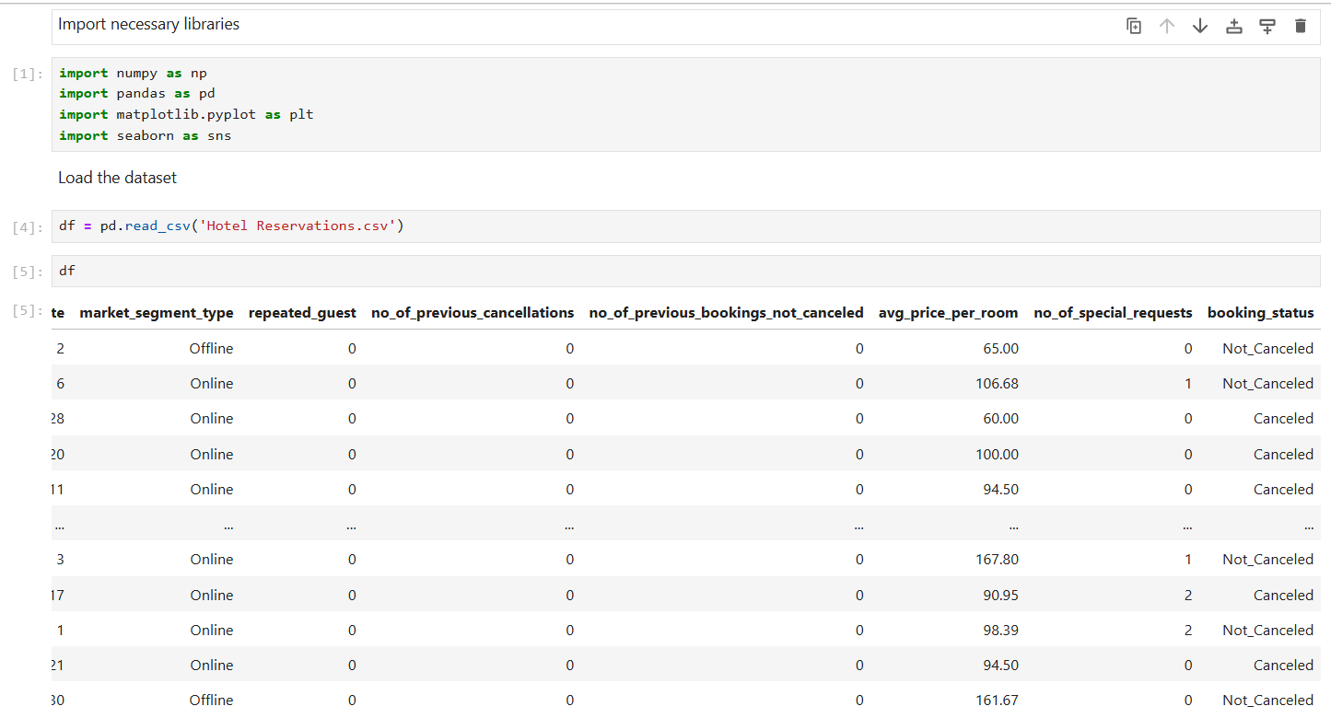

Slide 6


DATA CLEANING
Data cleaning is the process of identifying, correcting, and removing inaccurate, incomplete, or irrelevant data from datasets.
REMOVE DUPLICATES:
HANDLE MISSING VALUES:
CORRECT ERRORS:
STANDARDIZE DATA:
VALIDATE DATA:
FILTER OUTLIERS:
REMOVE IRRELEVANT DATA:
VERIFY DATA TYPES:

Slide 7
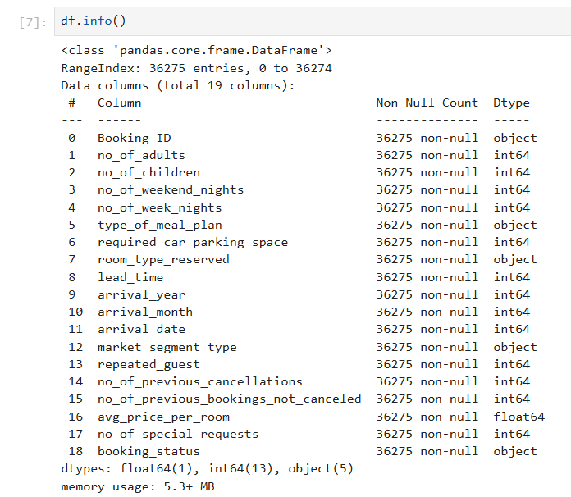
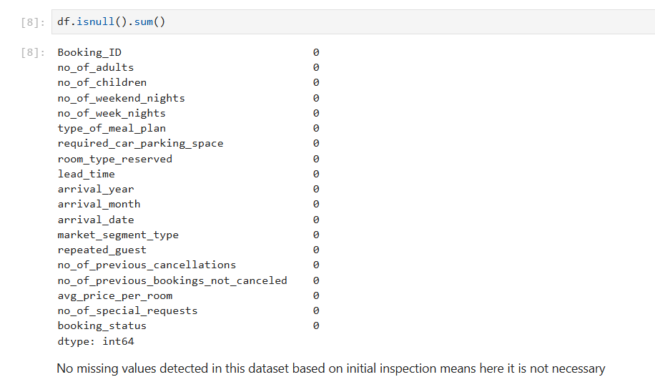

Slide 8
EDA
Exploratory Data Analysis (EDA) is the process of summarizing, visualizing, and analyzing datasets to uncover patterns, trends, and insights.
Understand data structure
Handle missing values:
Univariate analysis:
Bivariate analysis:
Multivariate analysis:
Outlier detection:
Data visualization:
Summary statistics

Slide 9

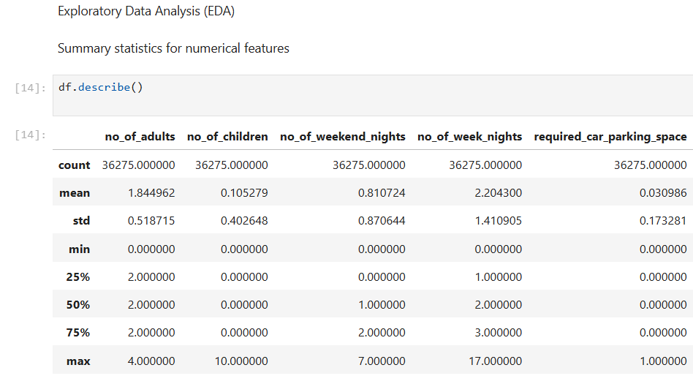

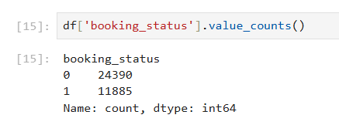

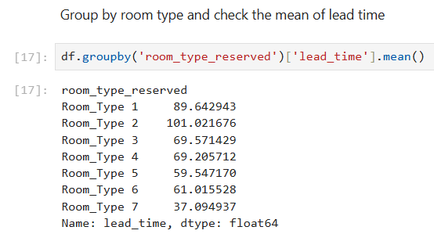
Summary statistics are numerical values that provide a quick overview of a dataset, helping to describe its main features. Key metrics include:
Mean: Average value.
Median: Middle value.
Mode: Most frequent value.
Standard deviation: Measure of data spread.
Range: Difference between the highest and lowest values.
These statistics help summarize and understand data distribution and variability.

Slide 10
DATA VISUALIZATION
Data visualization is the graphical representation of data using charts, graphs, and plots to reveal patterns, trends, and insights.
In a bar plot of booking status by meal plan, you're visualizing the relationship between two variables:
Booking status: Categories like "confirmed," "canceled," or "pending."
Meal plan: Types such as "breakfast only," "half board," or "full board."

Slide 11
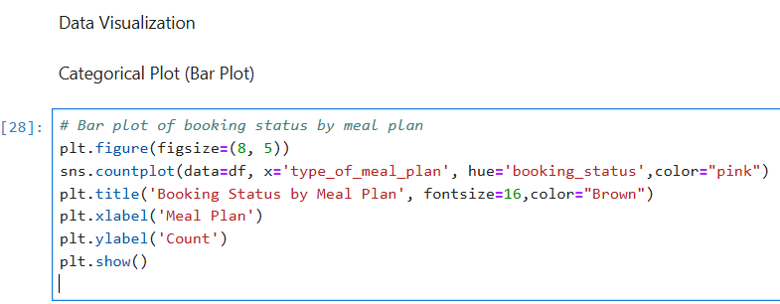
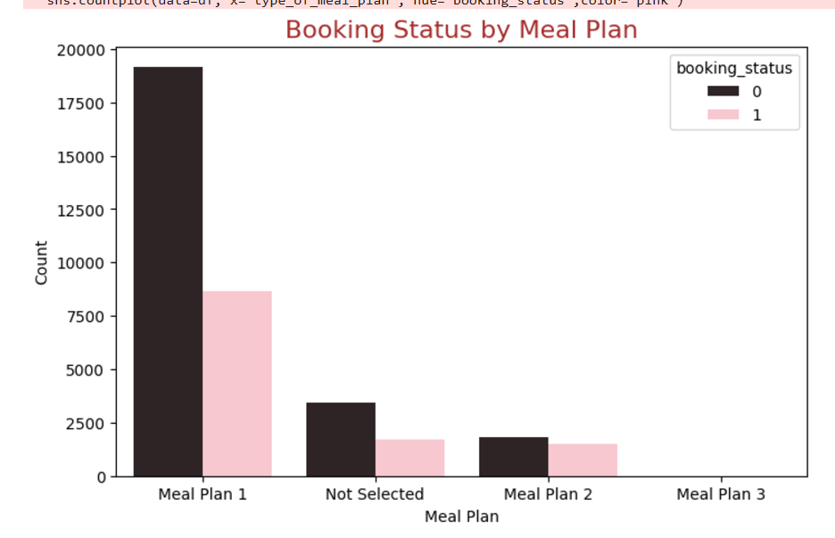

Slide 12


